Slide 1
Project overview :Object detection using deep learning
Mohammadreza Haghighat
Supervisor : Mohamad taghizadeh
Iran Deep learning center

Slide 2

Main tools : - Architecture - Model - Dataset - Implementation Tools
1 of 7

Slide 3
Single Shot MultiBox Detector (SSD) : - Hypothesize bounding boxes - Resample pixels or features for each box - Apply a classifier The Single Shot MultiBox Detector (SSD) eliminates the multi-stage process above and performs all object detection computations.
1 of 7

Slide 4
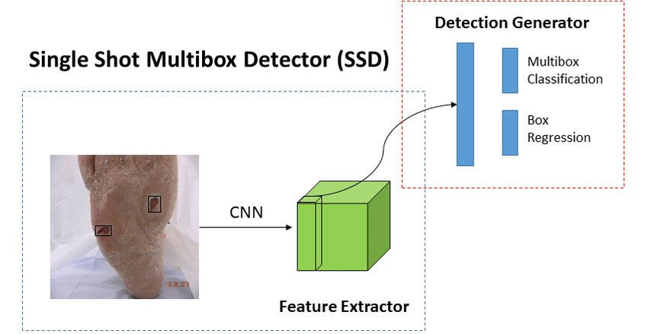
SSD Model
4 of 7

Slide 5
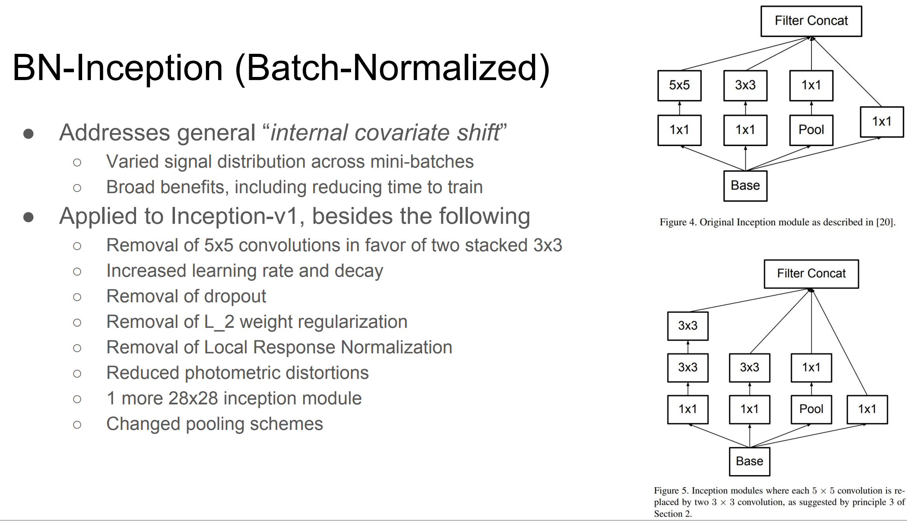
Inception architecture
<number> of 7

Slide 6
Data Set
The ssd_inception_v2_coco model used in this project is pretrained on the common objects in context (COCO data set), a large-scale data set that contains 1.5 million object instances and more than 200,000 labeled images
COCO is a large-scale object detection, segmentation, and captioning dataset. COCO has several features:
Object segmentation
Recognition in context
Superpixel stuff segmentation
330K images (>200K labeled)
1.5 million object instances
80 object categories
91 stuff categories
5 captions per image
<number> of 7

Slide 7
Thank you.
<number> of 7

